Slide 1





Symbolic wheel of fortune: Confusion analysis and the mental representations of digits across cultures
Garrett^{1,3}, Howard¹, Bennett¹, Hsieh², Yang², Little³, & Eidels¹
1. University of Newcastle, Australia
2. National Cheng Kung University, Taiwan
3. The University of Melbourne, Australia
@PaulMGarrett
Paul.Garrett@unimelb.edu.au

Slide 2
1
3
5
Background
Method
Results
Summary
@PaulMGarrett

Slide 3

3
Background
Method
Results
Summary
@PaulMGarrett

Slide 4

?
Background
2
3
8
Method
Results
Summary
@PaulMGarrett

Slide 5
?
Background
Numerical Distance
‘Proximity’
3
Perceptual Distance
‘Similarity’
2
8
Method
Results
Summary
Digit Confusions == Distance in the Mental Space
Not all confusions are the same
@PaulMGarrett

Slide 6
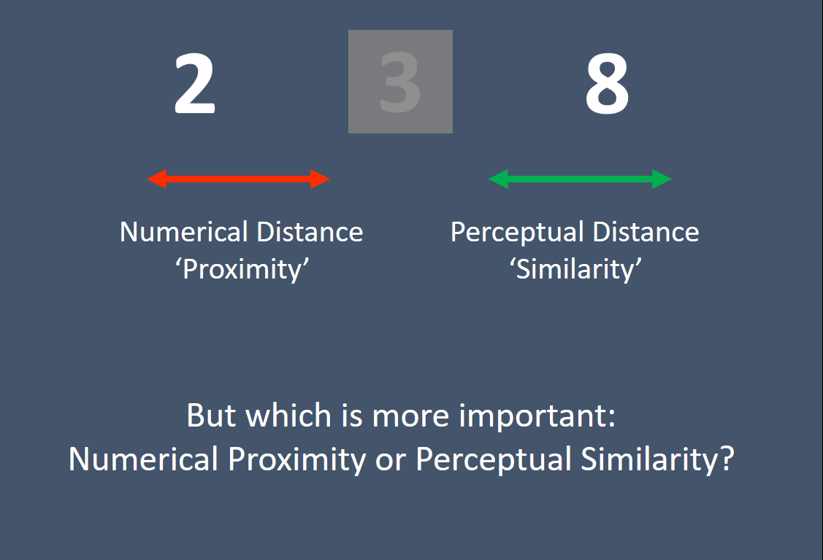
Background
Method
Results
Summary
@PaulMGarrett

Slide 7

Background
Method
Results
Summary
@PaulMGarrett

Slide 8




β
Գ
௧
Background
Method
፫
Results
||
Summary
2
@PaulMGarrett

Slide 9


















Background
Method
Results
Summary
@PaulMGarrett
1
2
3
4
5
6
7
8
9
Arabic
Chinses
Thai
Dots

Slide 10

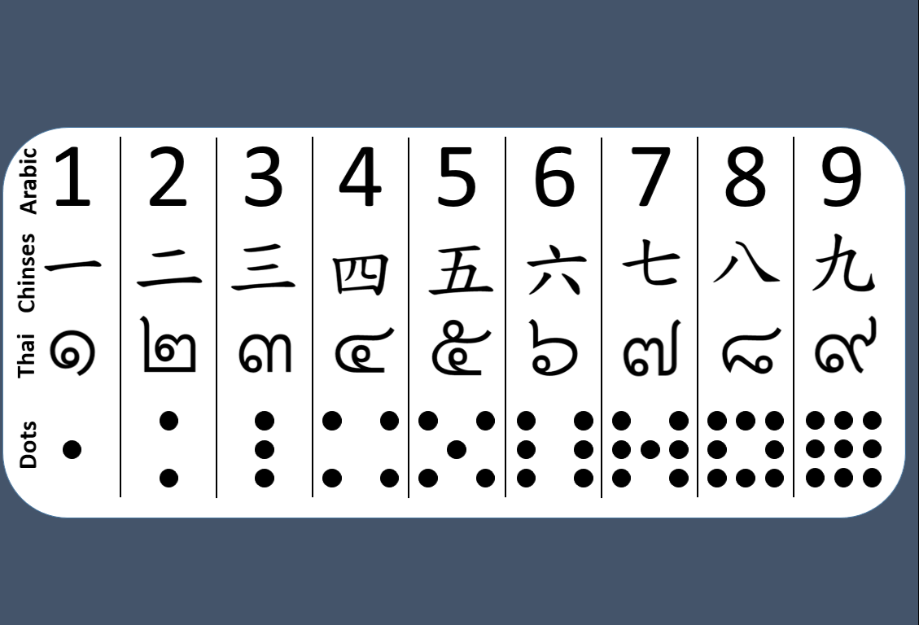
Taiwan (N = 11)
Newcastle (N = 11)
Background
Method
Results
Summary
@PaulMGarrett

Slide 11
Background
Method
Taiwan (N = 11)
Results
Summary
Newcastle (N = 11)
@PaulMGarrett
Why do we confuse numerals,
And how does this change across cultures?

Slide 12

*Staircase procedure during practice trials increased experimental confusions
Background
Method
500ms
Results
Summary
@PaulMGarrett

Slide 13

Background
Method
200ms
Results
Summary
@PaulMGarrett

Slide 14
1
9
7
4
Background
2
Method
8000ms
Results
6
Summary
3
5
8
@PaulMGarrett

Slide 15
1
9
7
4
Background
2
Method
8000ms
Results
6
Summary
3
5
8
@PaulMGarrett

Slide 16
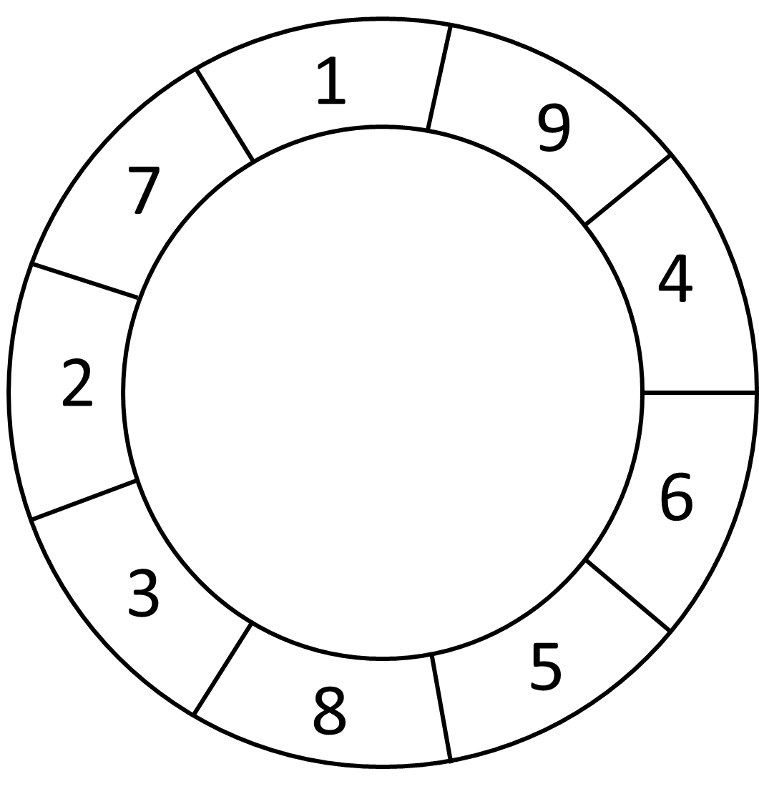
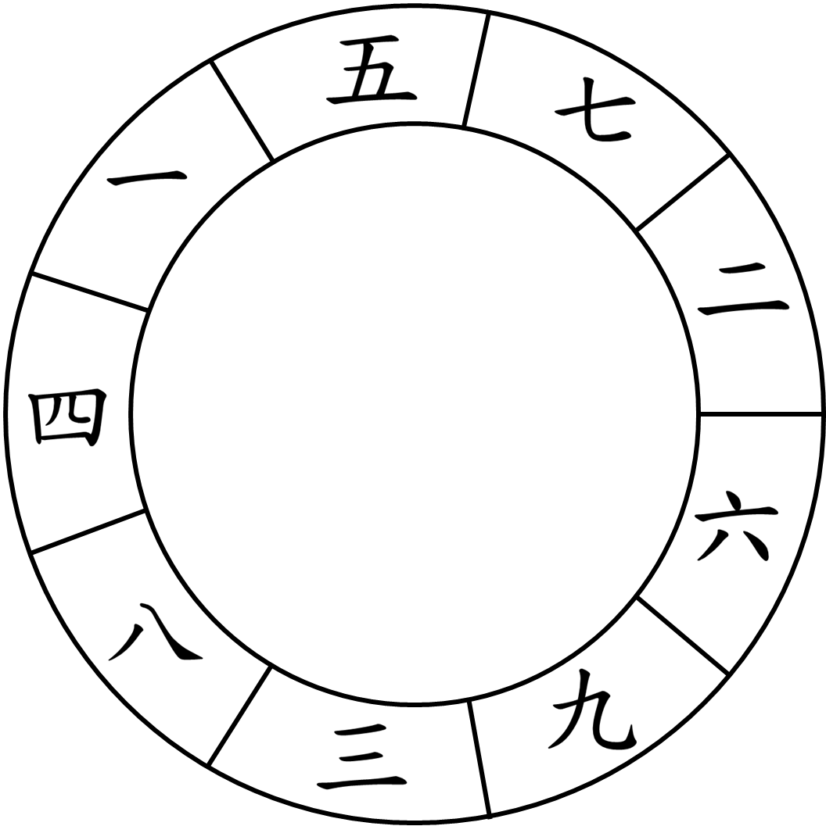
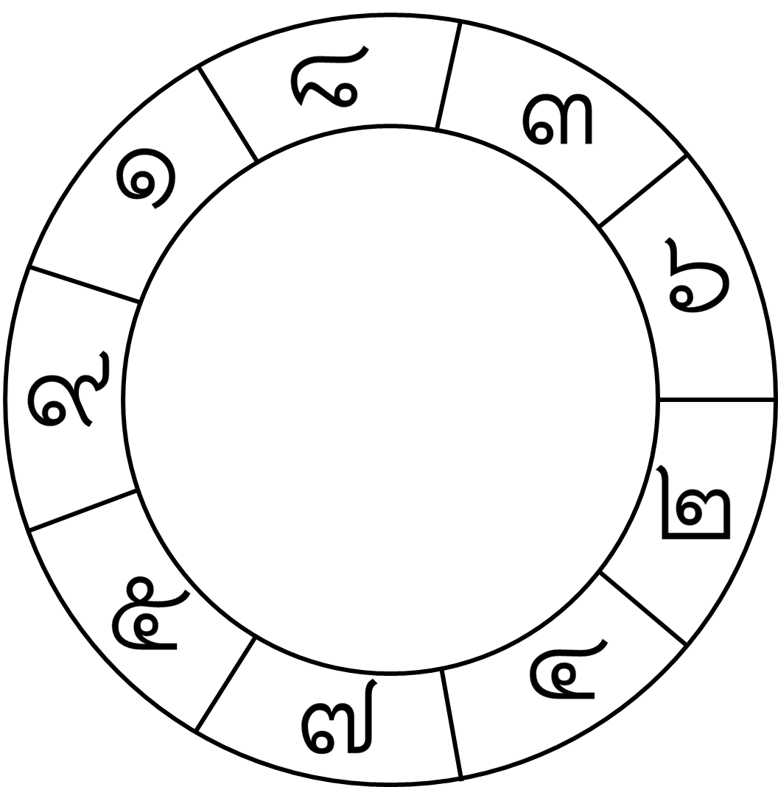
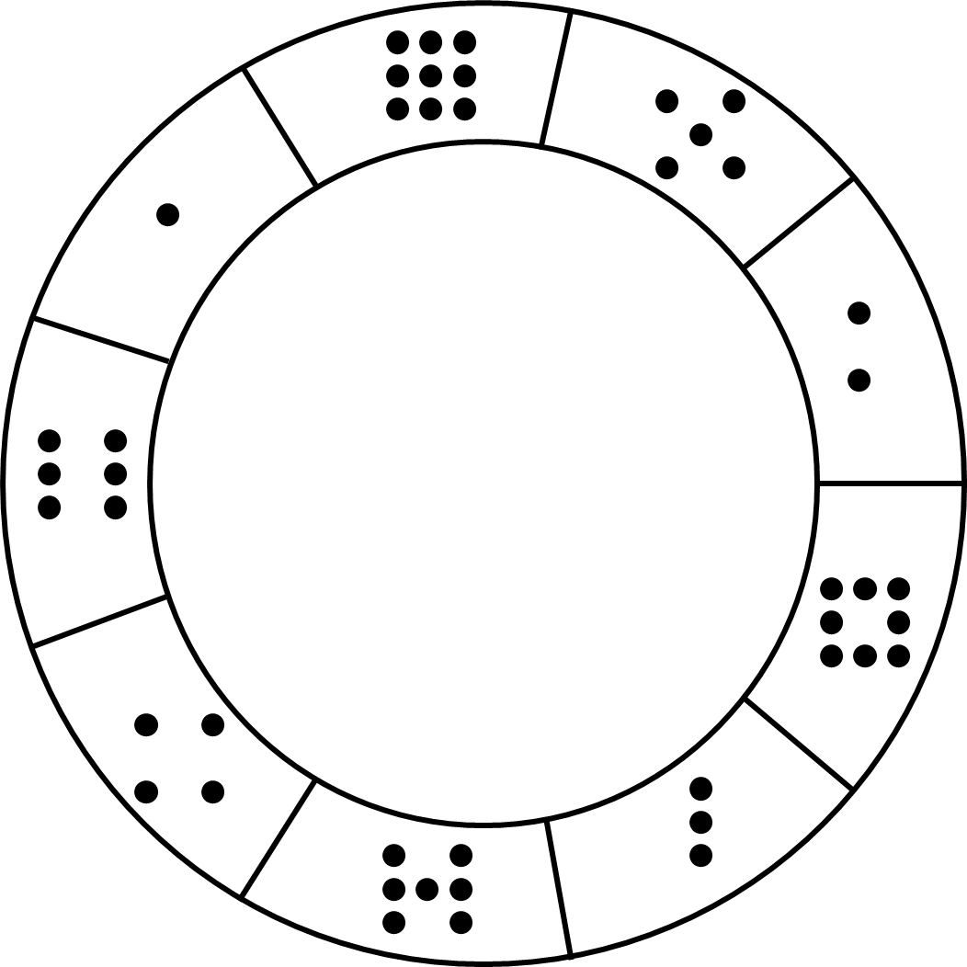
Procedure
4 x 90 min exp’s
$150 NTD or $25 AUS per/hr
135 practice trials
1170 exp trials
Acc Feedback
By trial – practice By block – exp
Background
Method
Results
Summary
@PaulMGarrett

Slide 17
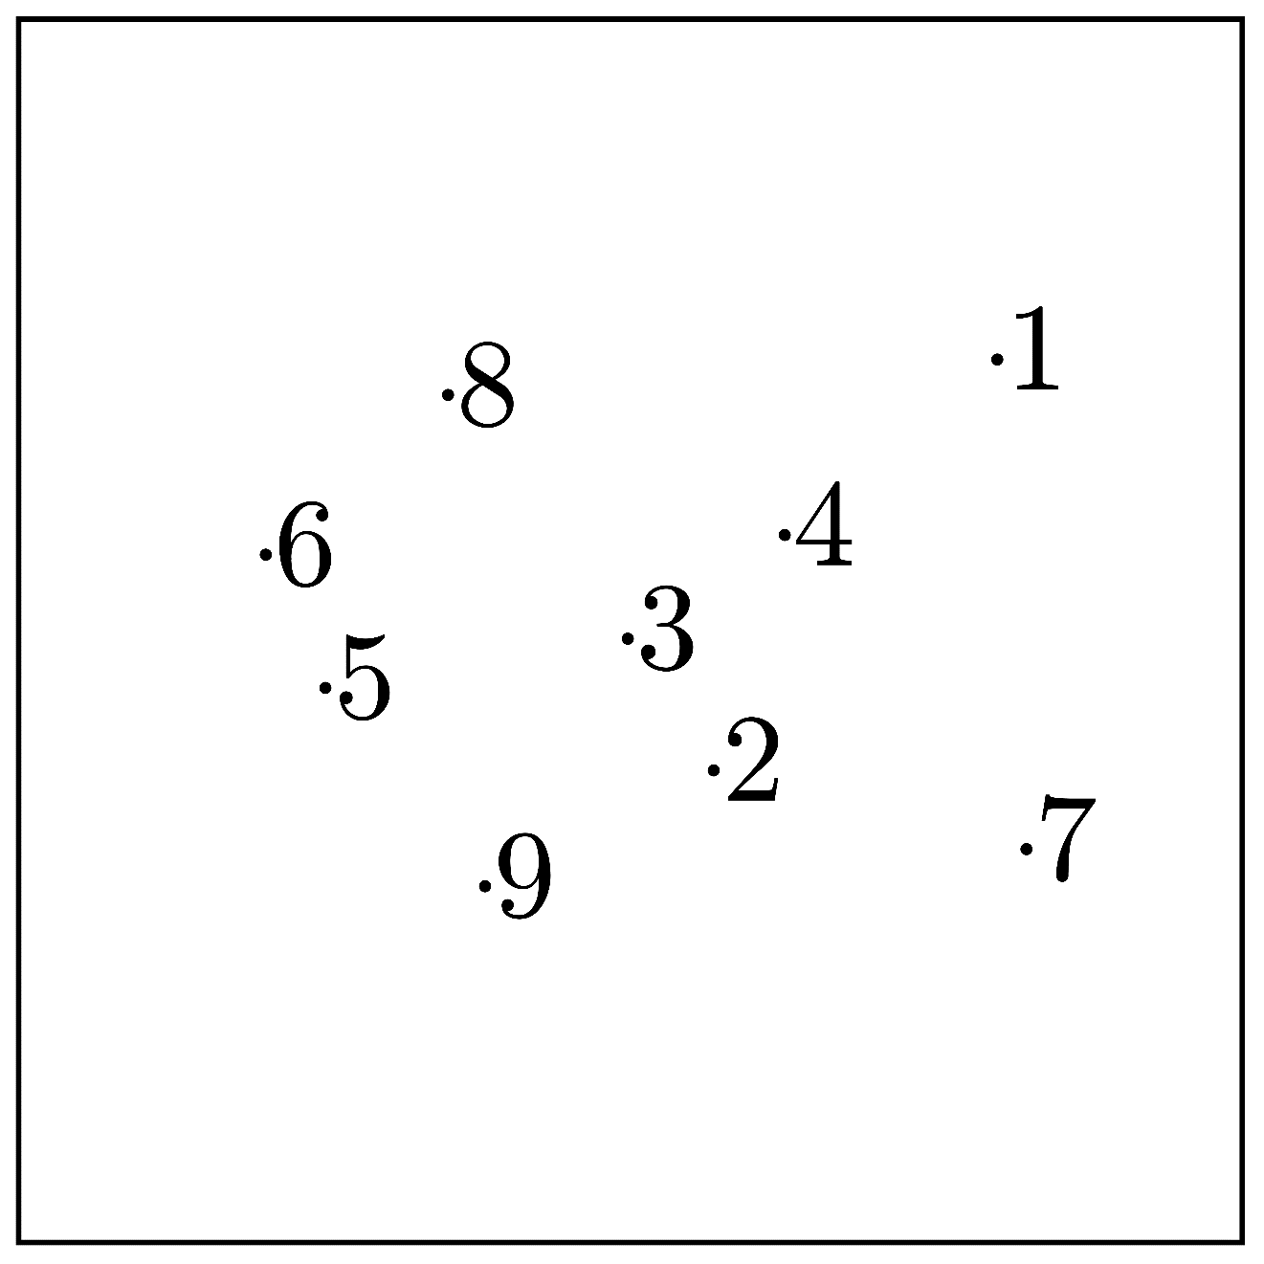
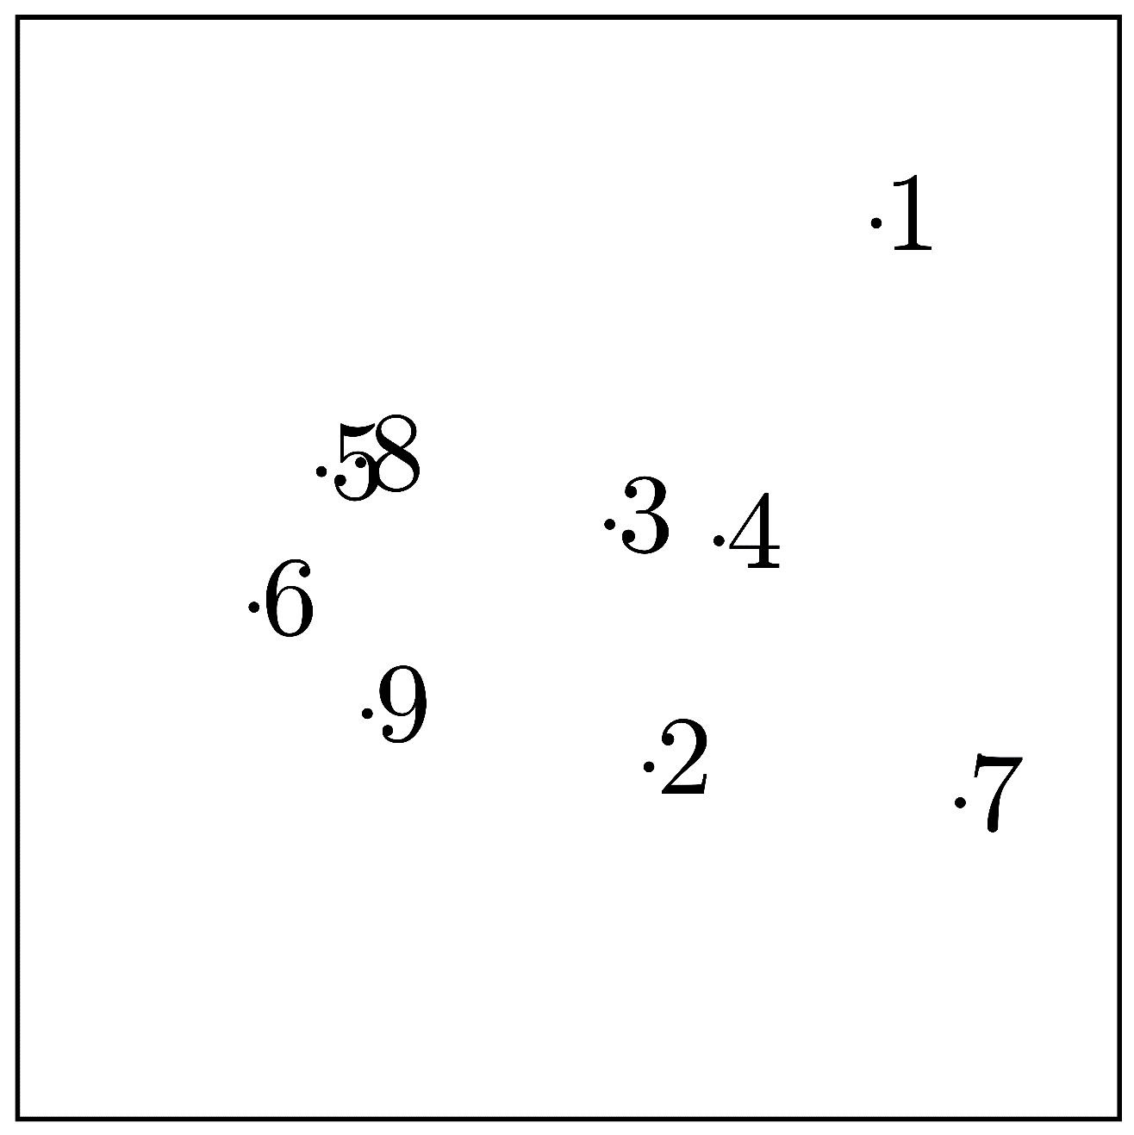
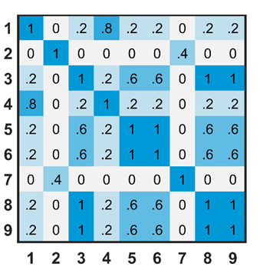
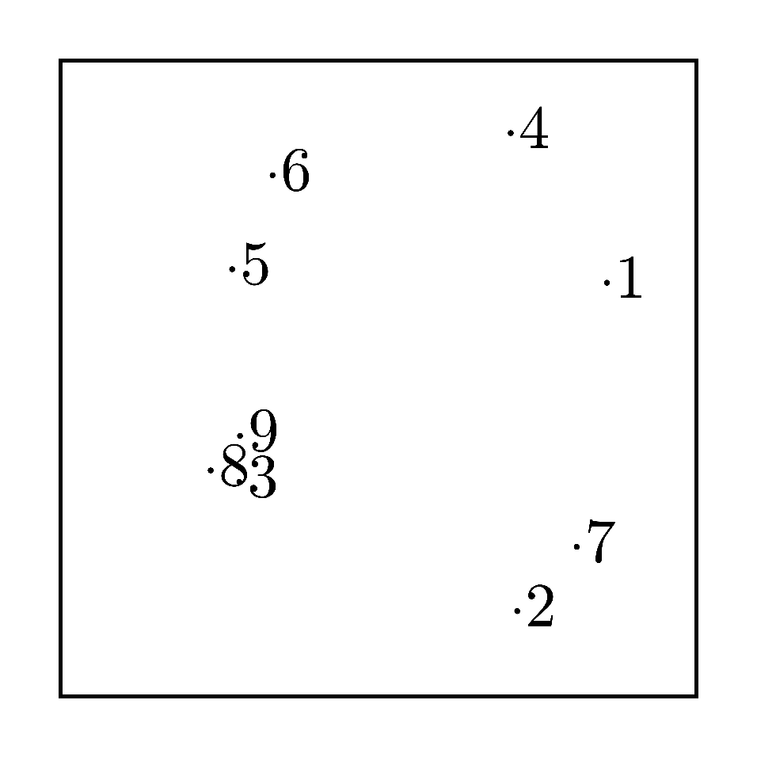
Experimental Procedure
Language (2x)
English
Chinese
Numeric Stimuli (4x)
Arabic
Chinese
Thai
Dots
Staircase Procedure
Luce’s Choice Model Corrected ‘Bias Free’ MDS
MDS
Confusion Data
Background
Method
Analysis
Multidimensional Scaling
Results
Biased Free MDS
Summary
INDSCAL Analysis
K-Mean Analysis
K-Mean Cluster Analysis
Group INDSCAL
@PaulMGarrett

Slide 18
Experimental Procedure
Language (2x)
English
Chinese
Numeric Stimuli (4x)
Arabic
Chinese
Thai
Dots
Staircase Procedure
ARABIC - ENGLISH
Confusion Data
Background
Analysis
CLOSED
Method
Multidimensional Scaling
Results
Biased Free MDS
OPENNESS
Summary
INDSCAL Analysis
K-Mean Cluster Analysis
OPEN
CURVED
STRAIGHT
ROUNDNESS
@PaulMGarrett

Slide 19
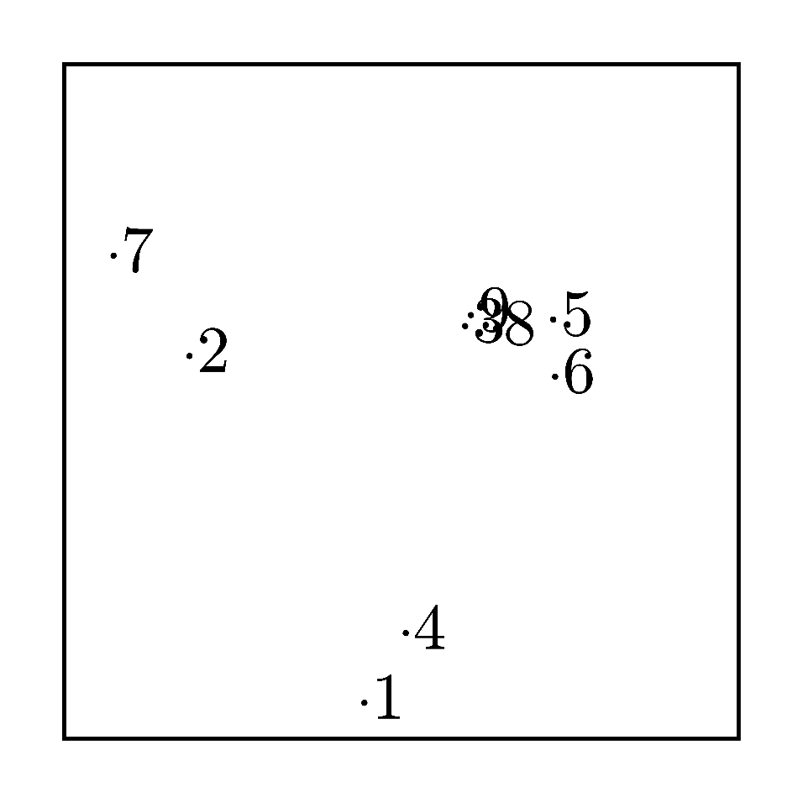
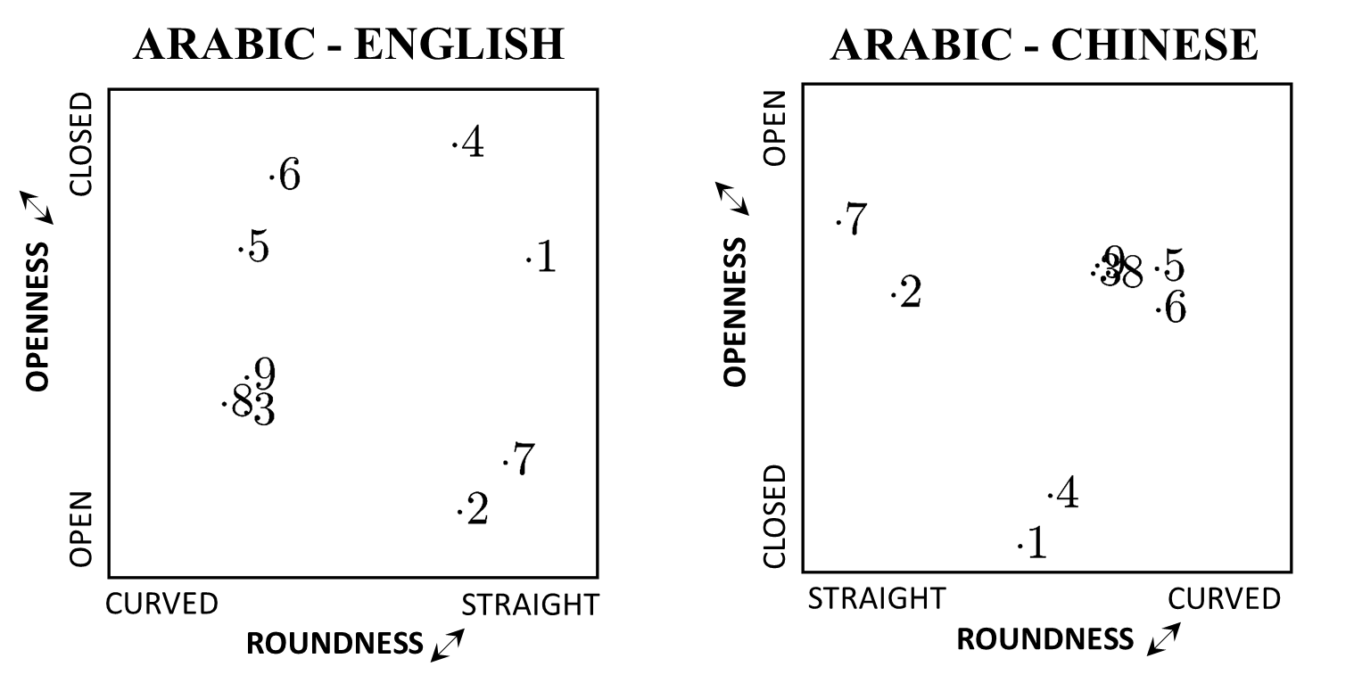
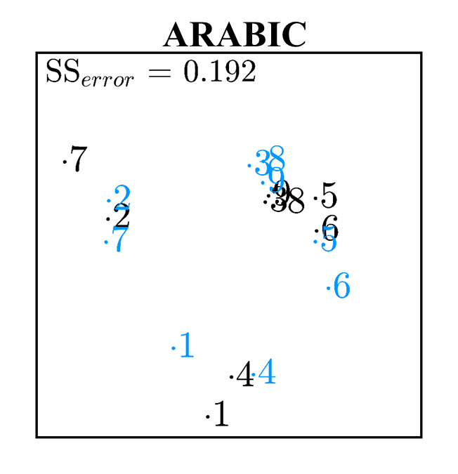
ARABIC - ENGLISH
ARABIC - CHINESE
Experimental Procedure
OPEN
CLOSED
Language (2x)
Numeric Stimuli (4x)
Staircase Procedure
OPENNESS
OPENNESS
Confusion Data
Background
Method
Analysis
OPEN
CLOSED
Multidimensional Scaling
Results
CURVED
STRAIGHT
STRAIGHT
CURVED
Biased Free MDS
ROUNDNESS
ROUNDNESS
Summary
INDSCAL Analysis
K-Mean Cluster Analysis
MDS Comparison
Procrustes Analysis
@PaulMGarrett

Slide 20
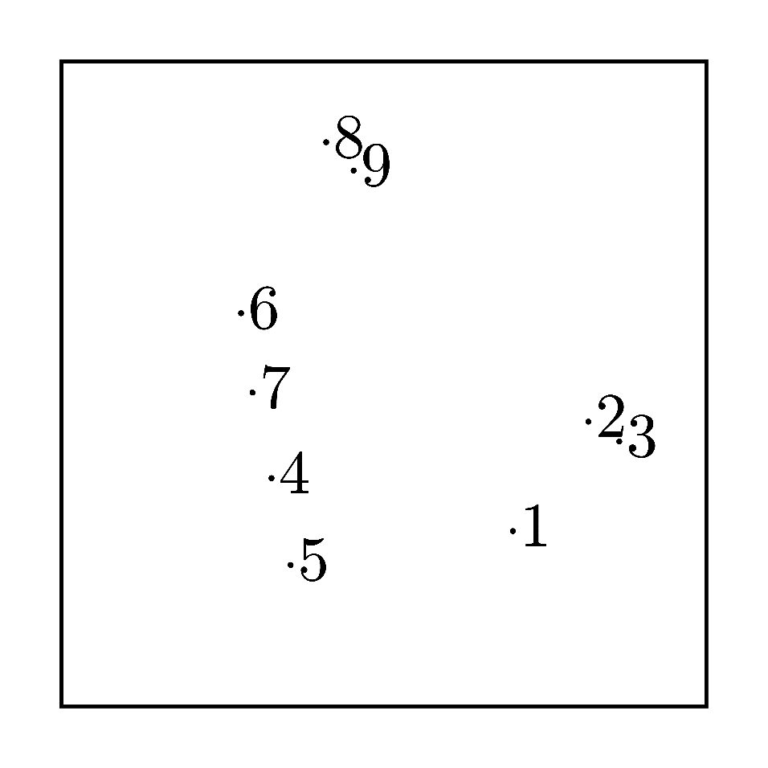
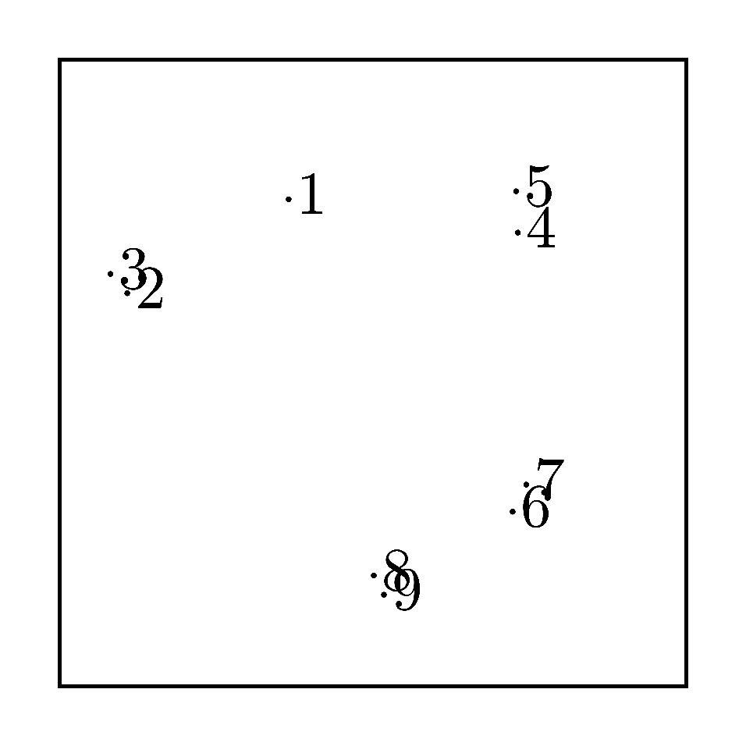
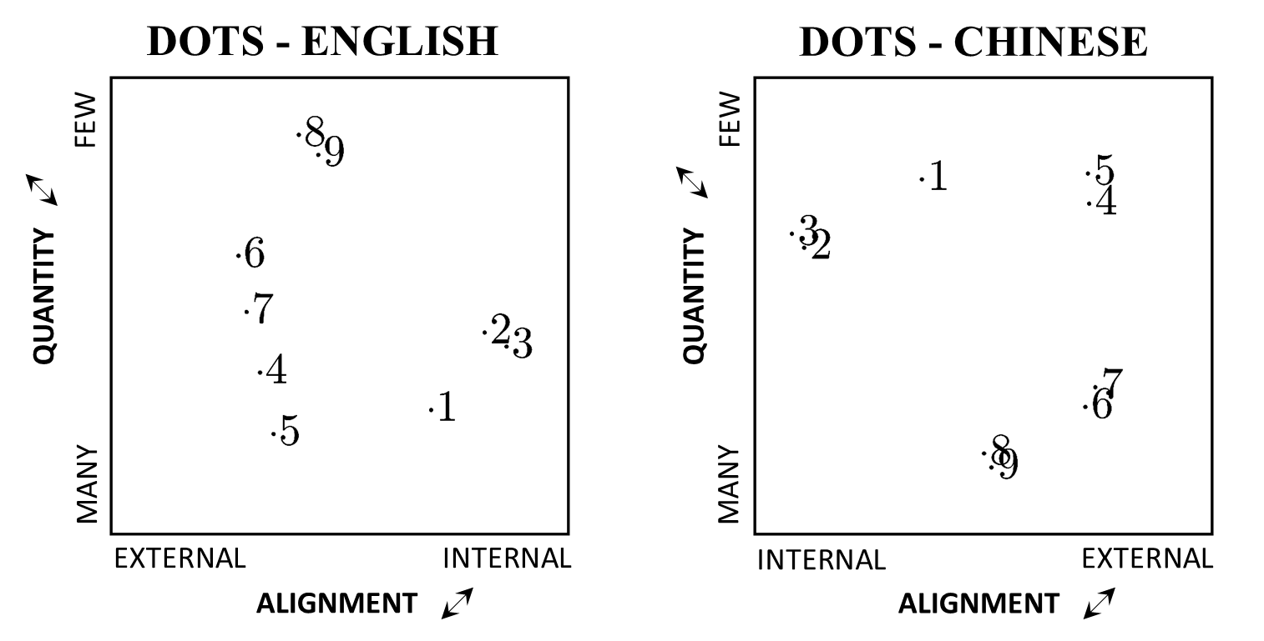
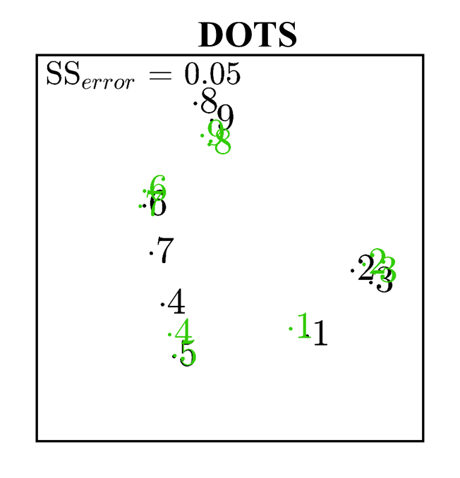
DOTS - ENGLISH
DOTS - CHINESE
Experimental Procedure
FEW
FEW
Language (2x)
Numeric Stimuli (4x)
Staircase Procedure
QUANTITY
QUANTITY
Confusion Data
Background
Method
Analysis
MANY
MANY
Multidimensional Scaling
Results
EXTERNAL
INTERNAL
INTERNAL
EXTERNAL
Biased Free MDS
ALIGNMENT
ALIGNMENT
Summary
INDSCAL Analysis
K-Mean Cluster Analysis
MDS Comparison
Procrustes Analysis
@PaulMGarrett

Slide 21
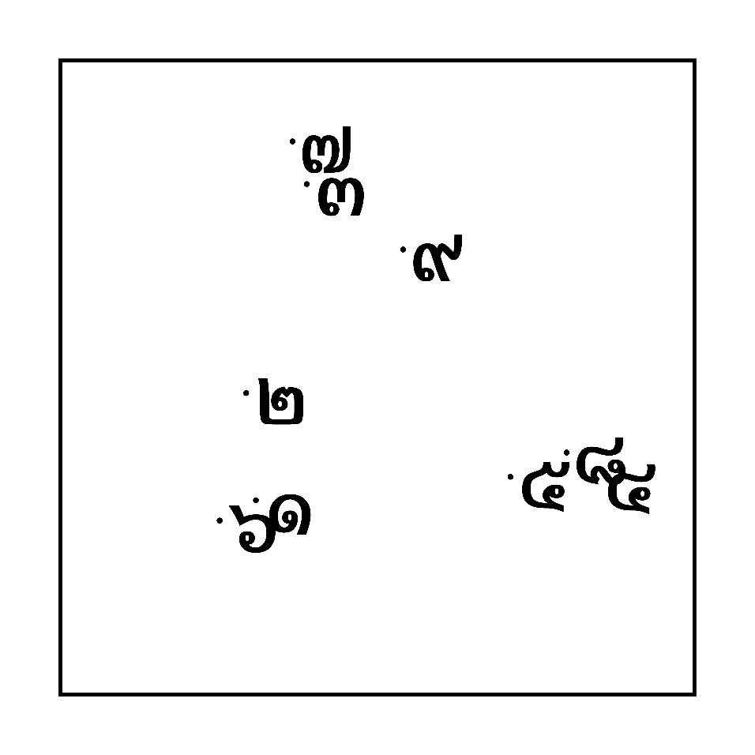
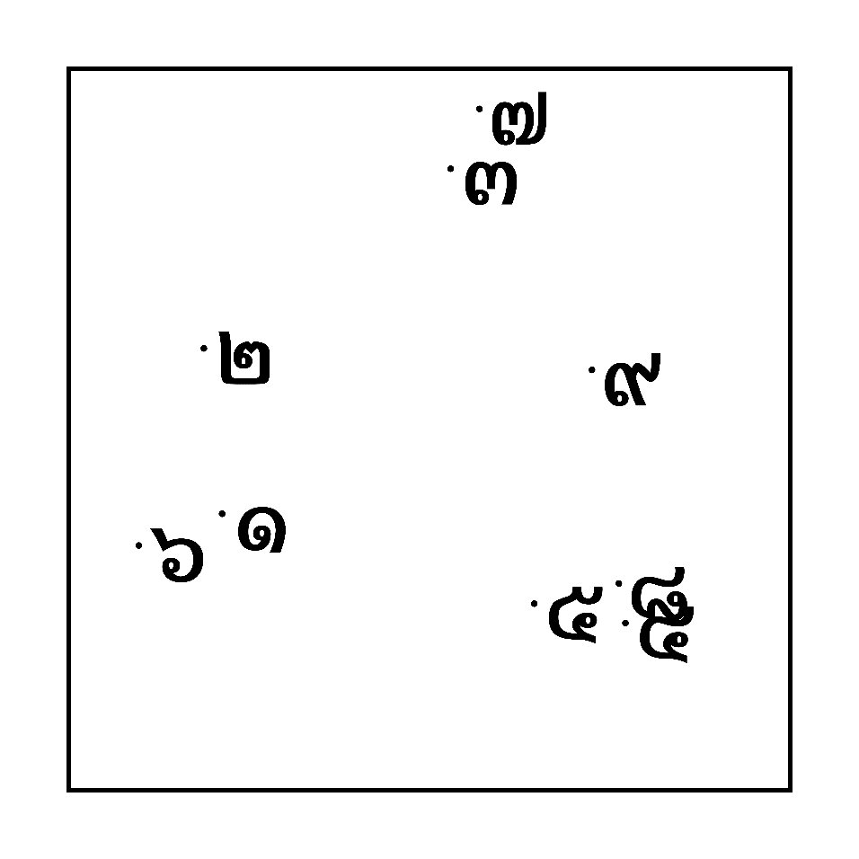
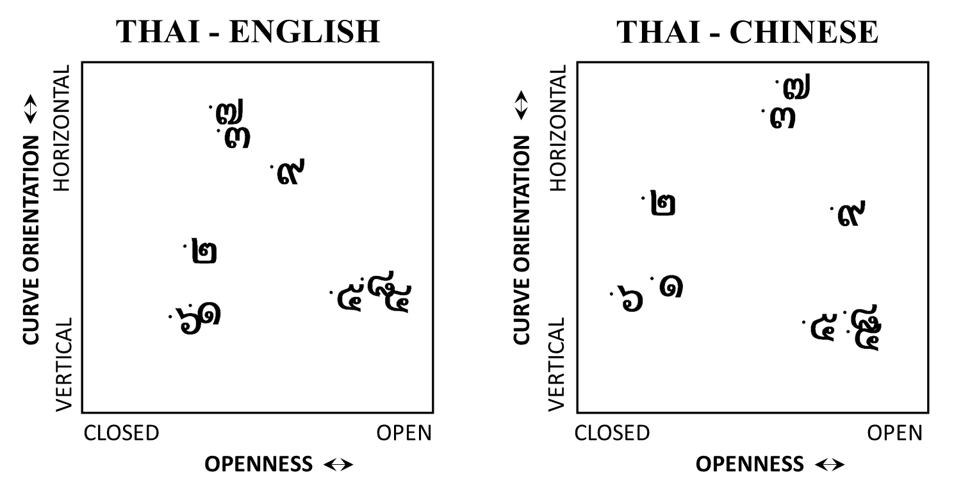
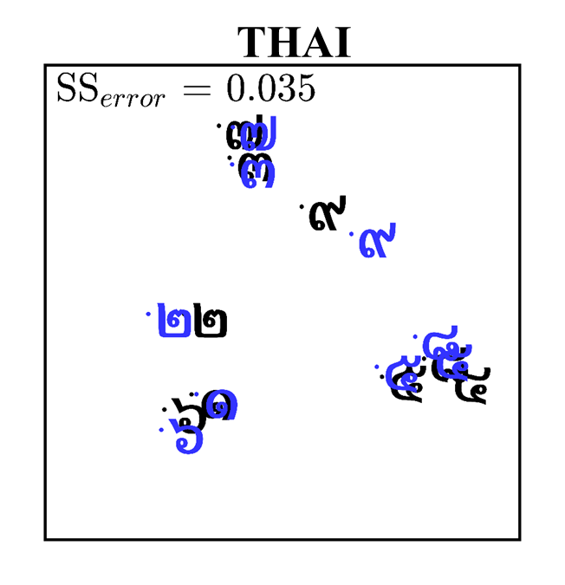
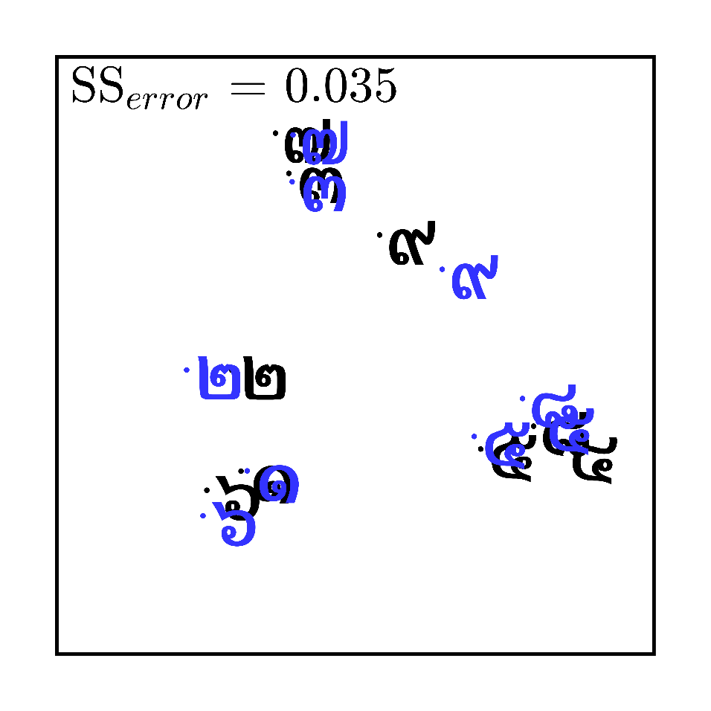
THAI - ENGLISH
THAI - CHINESE
Experimental Procedure
Language (2x)
HORIZONTAL
HORIZONTAL
Numeric Stimuli (4x)
Staircase Procedure
CURVE ORIENTATION
CURVE ORIENTATION
Confusion Data
Background
Method
Analysis
VERTICAL
VERTICAL
Multidimensional Scaling
Results
CLOSED
OPEN
CLOSED
OPEN
Biased Free MDS
OPENNESS
OPENNESS
Summary
INDSCAL Analysis
K-Mean Cluster Analysis
MDS Comparison
Procrustes Analysis
@PaulMGarrett
THAI

Slide 22
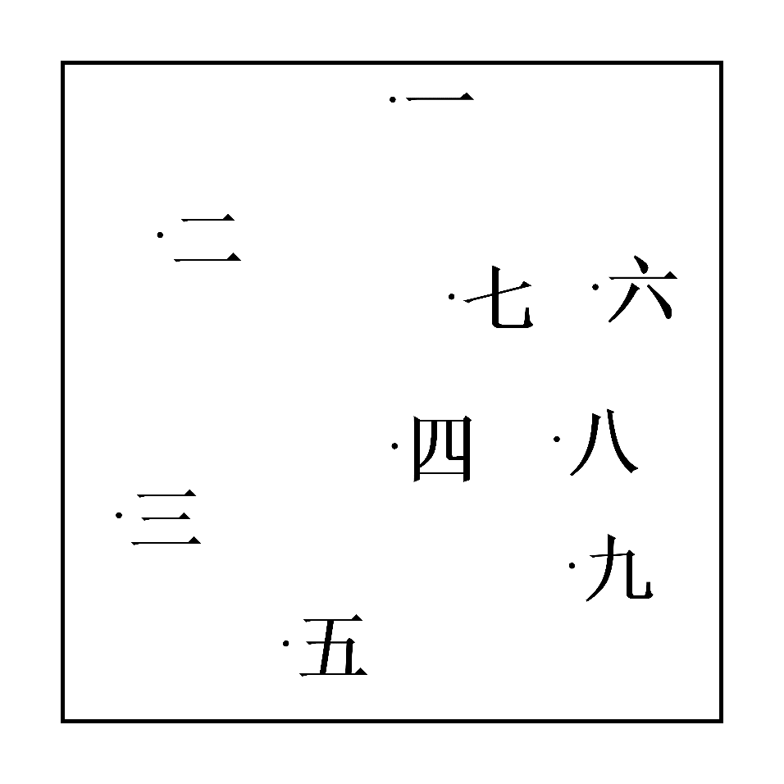
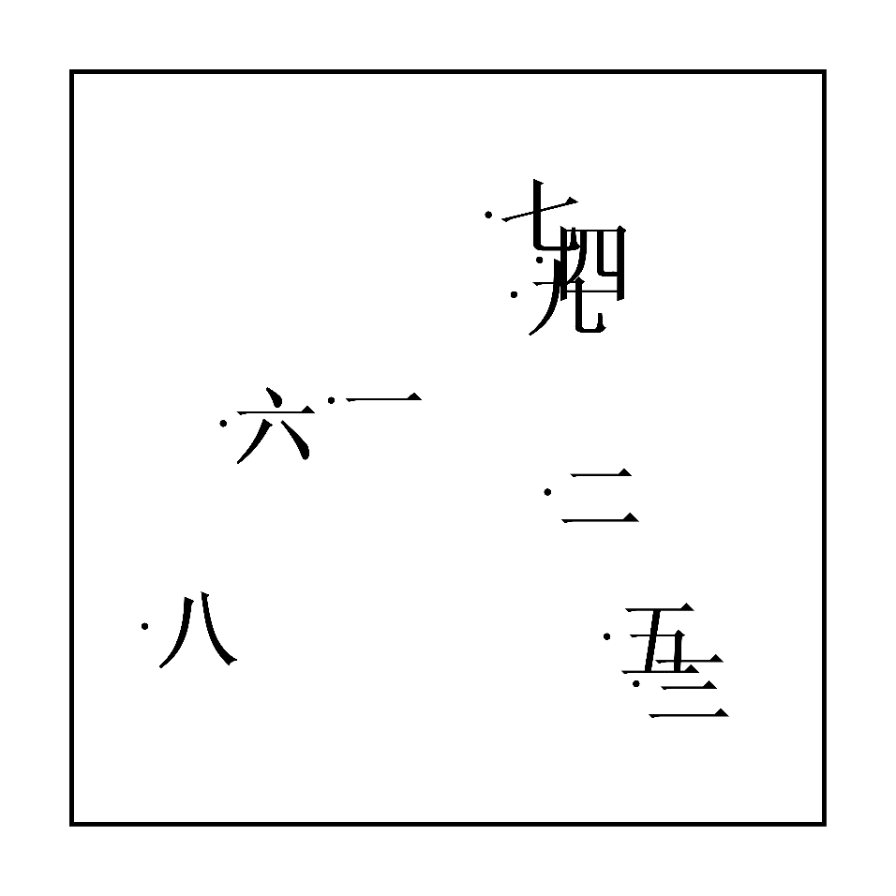
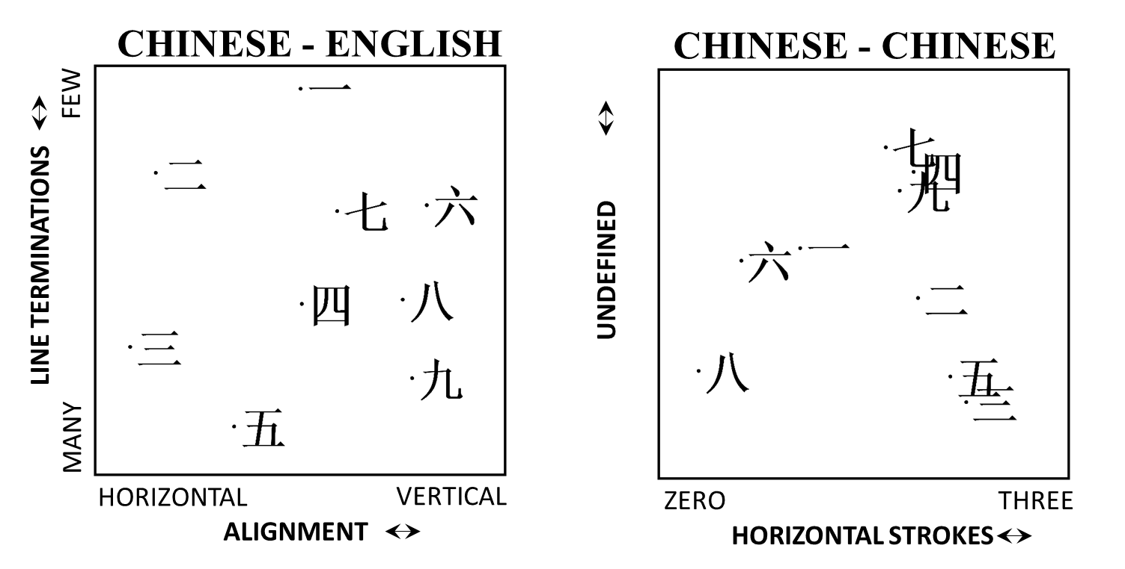
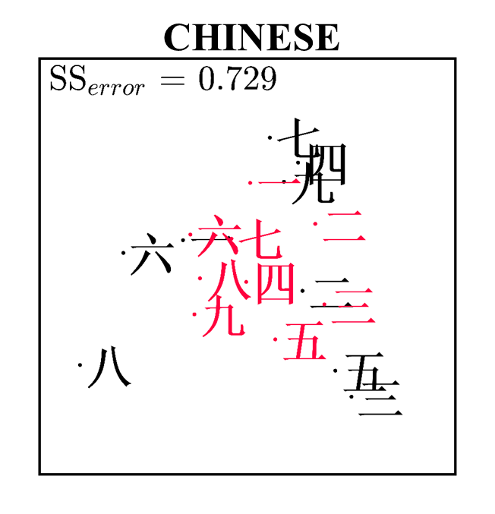
CHINESE - ENGLISH
CHINESE - CHINESE
Experimental Procedure
FEW
Language (2x)
Numeric Stimuli (4x)
Staircase Procedure
LINE TERMINATIONS
UNDEFINED
Confusion Data
Background
Method
Analysis
MANY
Multidimensional Scaling
Results
HORIZONTAL
VERTICAL
ZERO
THREE
Biased Free MDS
ALIGNMENT
HORIZONTAL STROKES
Summary
INDSCAL Analysis
K-Mean Cluster Analysis
MDS Comparison
Procrustes Analysis
@PaulMGarrett
Notes:
By radicals. The root component ‘kanji’ (in Japanese) for the Unknown axis .
By Bilateral symmetry (Xian)
By lucky numbers!! 4 unlucky (death), 7 prayers at a funeral, 9 (south China) not being generous – 1 and 6 quite lucky, 8 very lucky.
All of these!!

Slide 23
CHINESE - ENGLISH
CHINESE - CHINESE
FEW
Summary
Dimensions suggest Perceptual Similarity plays a greater role in digit confusions than Numerical Proximity.
Numerical Proximity only influenced Dot Stimuli – but maybe this is perceptual too…
Our findings held across English speaking and Chinese speaking participants.
Dimensions were (roughly) the same between cohorts for familiar and unfamiliar digits.
Chinese digits differed in the MDS space between cohorts, possibly due to familiarity/expertise.
LINE TERMINATIONS
UNDEFINED
Background
Method
MANY
Results
HORIZONTAL
VERTICAL
ZERO
THREE
ALIGNMENT
HORIZONTAL STROKES
Summary
@PaulMGarrett

Slide 24
CHINESE - ENGLISH
CHINESE - CHINESE
FEW
Further Directions
Interpretation of dimensional labels is highly subjective – interested in improving on this method.
Scree analysis was used to identify N dimensions. Quentin, Gronau, & Lee – could this data work within a Bayesian approach?
Do Chinese/English speakers use more/less dimensions to classify digits? Stimulus specific?
Exploration of expertise (familiarity) on the mental space!
LINE TERMINATIONS
UNDEFINED
Background
Method
MANY
Results
HORIZONTAL
VERTICAL
ZERO
THREE
ALIGNMENT
HORIZONTAL STROKES
Summary
@PaulMGarrett

Slide 25





CHINESE - ENGLISH
CHINESE - CHINESE
FEW
Thank you!
ZACHARY HOWARD
MURRAY BENNETT
AMI EIDELS
LINE TERMINATIONS
UNDEFINED
MANY
CHENG-TA YANG
YU-TZU HSIEH
HORIZONTAL
VERTICAL
ZERO
THREE
ALIGNMENT
HORIZONTAL STROKES
This work was supported by an ARC Discovery Project Grant DP160102360 to Ami Eidels and Daniel Little, the John and Daphne Keats endowment research fund G1700468 to Zachary Howard, Paul Garrett, Cheng-Ta Yang, Daniel Little and Ami Eidels, and a Ministry of Science and Technology of Taiwan grant MOST 107-2410-H-006-055-MY2 to Cheng-Ta Yang.
DANIEL LITTLE

Slide 26
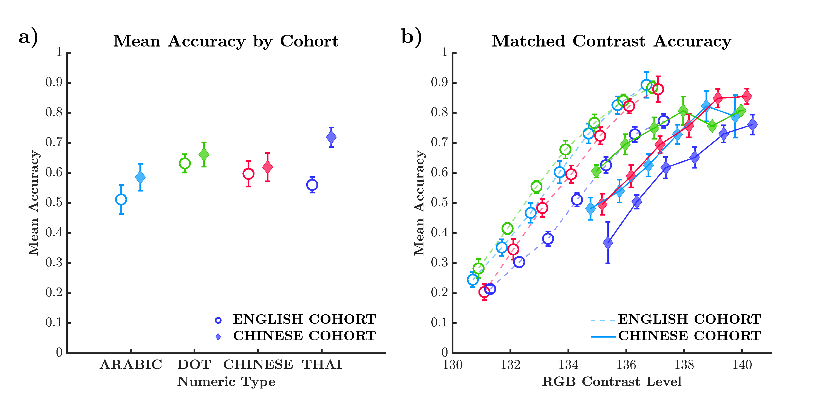

Slide 27
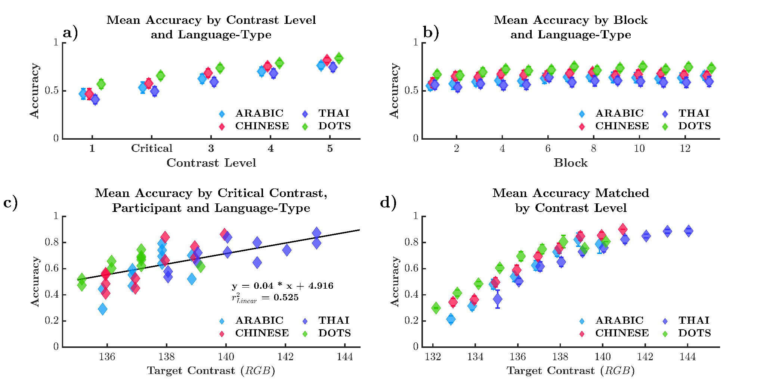

Slide 28
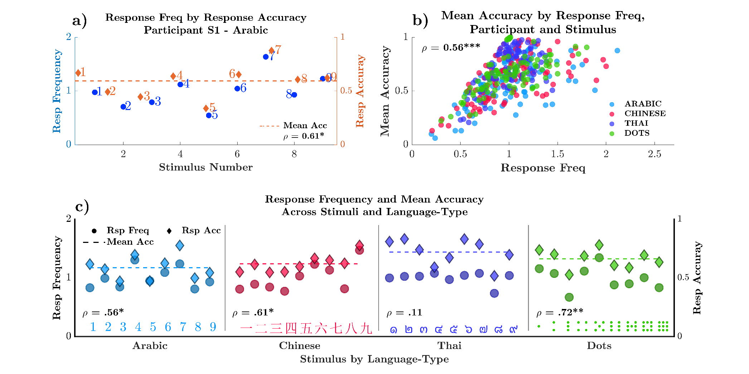

Slide 29
